Slide 1

CSE3BDC/CSE5BDC
Big Data Management on the Cloud
Lecturer: Zhen He
Lecture 3

Slide 2
Lecture Outline
Introduction to Hadoop
Hadoop Internals
Advanced MapReduce

Slide 3
Hadoop
The open source MapReduce implementation
Developed initially by Yahoo! in 2008.
The implementation is based on the following paper by researchers from Google, published in 2004
  Jeffrey Dean and Sanjay Ghermawat, MapReduce: Simplified Data Processing on Large Clusters, OSDI 2004
Hadoop has turned into THE platform for big data
According to Parikh, “Hadoop is used in every Facebook product and in a variety of ways.”

Slide 4













Who uses Hadoop?

Slide 5

What Hardware is Hadoop Designed for?
Nodes of commodity PCs connected via network
This is often called cluster of workstations
Each node has its own:
  Disk
  CPUs
  Memory
Very scalable architecture

Slide 6

Very Large Hadoop Deployment in Data Centers
Hadoop spread over thousands of shared nothing nodes/blades.
Nodes/blades are grouped into racks
Each node/blade within a rack has own
    memory, disk, CPUs
Communication within nodes/blades faster than across racks
  Higher bandwidth
  Lower latency

Slide 7
Minimize Data Movement
The shared nothing architecture of Hadoop mean data movement across nodes is expensive.
Goal of Hadoop is to minimize data movement
Move computation to data
The map phase computation does not generate any network traffic since it just operates on the data within its local partition
Minimize cost of data shuffle
  Write code that minimizes the amount of data shuffled.
  Better shuffle algorithms

Slide 8
Hadoop Internals

Slide 9
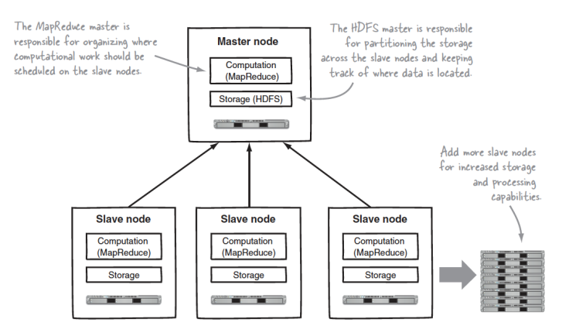
How does Hadoop Work?
Uses master slave architecture
The master node is the coordinator
  Schedules MapReduce Jobs
  In charge of where the data is spread across the slave nodes.
Two main layers of software
  MapReduce Computation Layer
  Distributed File System HDFS

Slide 10
Goals of Hadoop Distributed File System HDFS
Very Large Distributed File System
– 10,000 nodes, 100 million files, 10 PB
Assumes Commodity Hardware
– Files are replicated to handle hardware failure
– Detect failures and recovers from them automatically
Optimized for Batch Processing
– Move computation to data
– Provides very high aggregate bandwidth

Slide 11
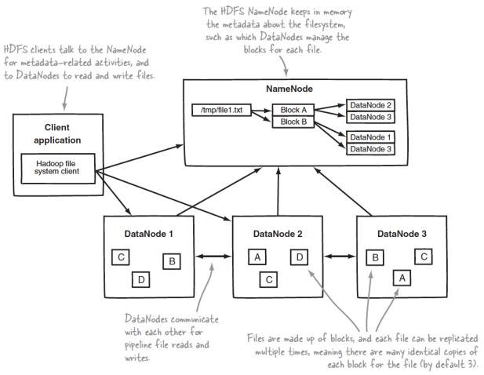
HDFS: DataNodes / NameNode
Data split into fixed sized blocks (typically 128 MB)
By default each block is replicated across 3 data nodes (example above shows replication across 2 data nodes)
Master slave architecture
  MasterNode: NameNode
  SlaveNodes : DataNodes

Slide 12
HDFS: DataNodes / NameNode
NameNode
  Stores the meta data
    Meta data contains the location of where the different data blocks reside.
DataNodes
  Stores the actual data blocks.
Client application first communicates with the NameNode to find where the data resides and then directly contacts the DataNodes to get the required data.

Slide 13
Hadoop Distributed File System HDFS
Single Namespace for entire cluster
Data Coherency
– Write-once-read-many access model
– Client can only append to existing files
Files are broken up into blocks
– Typically 128 MB block size
– Each block replicated on multiple DataNodes

Slide 14
NameNode Metadata
Meta-data in Memory
– The entire metadata is in main memory
– No demand paging of meta-data
Scalability of HDFS determined by memory size of NameNode
  Usually put NameNode on a bigger more powerful server with more memory than DataNodes
Types of Metadata
– List of files
– List of Blocks for each file
– List of DataNodes for each block
– File attributes, e.g creation time, replication factor

Slide 15
DataNode
A Block Server
  Stores data in the local file system (e.g. ext4)
  Stores meta-data of a block (e.g. CRC)
  Serves data and meta-data to Clients
Block Report
  Periodically sends a report of all existing blocks to the NameNode
    If no block report received by NameNode within certain time frame (say 30 minutes) then assume DataNode down
      Replicate all blocks of the failed DataNode to other DataNodes
Facilitates Pipelining of Data
  Forwards data to other specified DataNodes
    Next slide shows what happens when data is written into HDFS

Slide 16
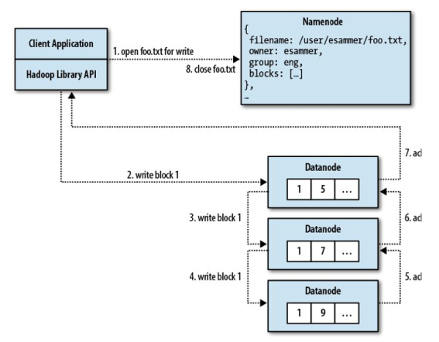
Write Path in HDFS
Example of writing a new file.
Client first sends write request to NameNode
NameNode tells client which DataNodes to write the first block into.
Client send first block to the first DataNode
  Written into the local filesystem of the first DataNode
The first DataNode copies the block to the second DataNode (pipeline)
The second DataNode copies the block to the third DataNode (pipeline)
Then acknowledgements of successful write is propagated back to the client
The above is repeated for the 2nd block.
  The NameNode is again contacted to determine where to write the 2nd block
The above approach minimizes the amount of contact needed to the Namenode.
  More scalable.

Slide 17
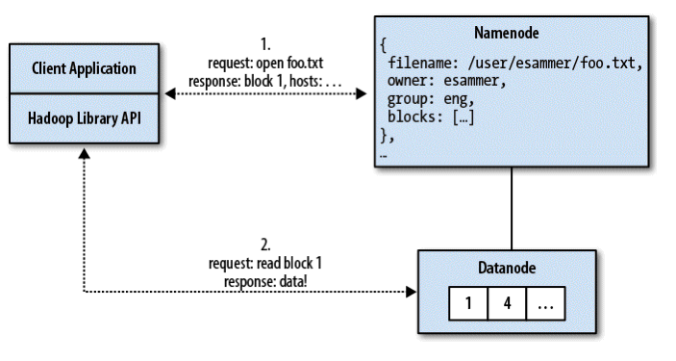
Read Path in HDFS
Client requests a file to read
NameNode tells the client the location of the three replicas of the first block of the file.
  The locations are sorted in terms of distance to the client incorporating rack topology knowledge
Client then gets the block from the nearest node.
  Client will try to get from a different node if block returned is corrupt due to checksum not matching.

Slide 18
HDFS blocks and local storage
The HDFS logical blocks are actually stored as files in the local file system
For example a file is divided into two blocks A and B.
A file will be created inside the local file system of each data node to store block A. The same for block B.

Slide 19
Small Files
If a file is 100 bytes in size, it will occupy one HDFS block.
However, the block will be stored in a 100 byte file in the local file system of the Datanodes.
Therefore there is no waste of space.
However, having a lot of small files is bad since the Namenode need to keep track of it all.
  The total meta data size of many small files maybe too big to fit in the RAM of the Namenode.

Slide 20
Data Correctness
Use Checksums to validate data
– Use CRC32
File Creation
– Client computes checksum per 512 byte
– DataNode stores the checksum
File access
– Client retrieves the data and checksum from DataNode
– If Validation fails, Client tries other replicas

Slide 21
Rebalancer
Goal: % disk full on DataNodes should be similar
  Moves blocks around to balance number of blocks per DataNode
    Computational parallelism also depends on where the data resides
  Usually run when new DataNodes are added
  Rebalancer is throttled to avoid network congestion
  Command line tool

Slide 22
NameNode Failure
A single point of failure
All meta data (where data blocks reside, etc.) kept in RAM.
What happens when the NameNode dies?
  All the contents in DataNodes are no longer accessible. We do not know where any of the data resides.
The edits log
    A log of all the changes that have occurred to the meta data
      E.g. the deletion of blocks, insertion of blocks, etc.
fsimage
  Contains the latest snapshot of the meta data.
During recovery
  Load fsimage and then replay edit logs to get up-to-date.

Slide 23
Secondary NameNodes
The old snapshot (fsimage) may become too old.
  edits log also gets too large
  If recovery is needed then it will take a long time to reply all the edits.
The idea is to create a new fsimage by playing back the edits.
This is very computationally expensive
Use a different node to do this in the background
  Secondary NameNode
  Usually on a different machine from the NameNode itself.

Slide 24
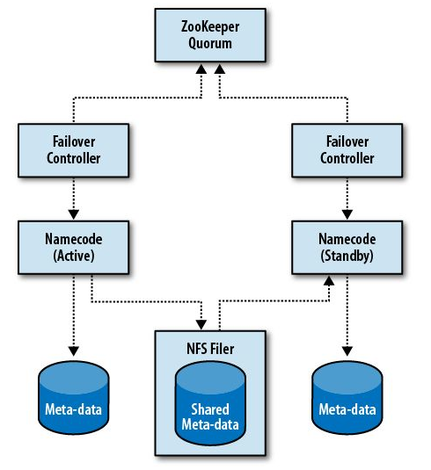
NameNode High Availability
During failure recovery replying edits takes a long time
  Results in long down time for entire Hadoop cluster.
Have a standby NameNode
  Standby NameNode constantly replaying the edits log to keep an almost-up-to-date in RAM image of the active NameNode meta data.
The new edits are appended to an edits log which is stored over NFS
  The standby NameNode gets the new edits from the log stored over NFS.
During failure the system will automatically failover to the standby Namenode.
No secondary node needed when we have a standby NameNode.
There can be only one active NameNode at one time.
  ZooKeeper is a distributed consensus service which can be used to elect a single node as the active NameNode.

Slide 25
MapReduce Scheduler

Slide 26
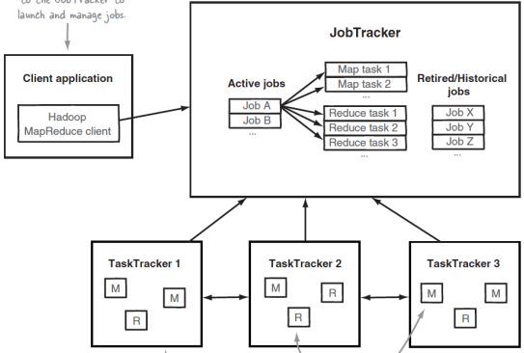
MapReduce Task Scheduling Architecture

Slide 27
MapReduce Task Scheduling Architecture
Again using master-slave model
  Master: JobTracker
  Slaves: TaskTrackers
Jobs: An entire MapReduce job, e.g. word count
Tasks: Jobs are divided into a set of map tasks and reduce tasks.
The JobTracker
  A daemon running on the master node
  Takes a job and divides it into map and reduce tasks and issues them to the task trackers (slaves).
  Tasks issued to nodes which contain the data
    Move computation to data.
The TaskTrackers
  Each slave node runs its own TaskTracker daemon
  Runs tasks locally and reports to the JobTracker.

Slide 28
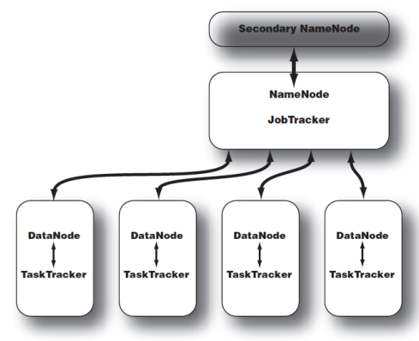
Typical Hadoop Cluster
Master/Slave Architecture
Master node contains both
  NameNode (HDFS)
  JobTracker (MapReduce Scheduler)
Each slave node contains both
  DataNode ( HDFS)
  TaskTracker (MapReduce Scheduler)

Slide 29
JobTracker
One JobTracker per Hadoop cluster
JobTracker determines execution plan
  Which files to process
  Assigns nodes to different tasks
  Monitors all running tasks
Single point of failure
  Use reliable hardware
TaskTracker sends regular heartbeats to JobTracker
  Heatbeat includes progress indicator
    JobTracker uses this information to determine the progress of each TaskTracker
  If no heartbeat received then slave node is assumed to be dead and its tasks are reassigned to a different TaskTracker
JobTracker is similar to an operating system scheduler
  Deciding which node to send each task to
  Always tries to send the task to the node containing the data.
  Unlike operating system scheduler it allows jobs to run to completion.

Slide 30
TaskTracker
  Always a single TaskTracker on each worker node
  Each TaskTracker and DataNode run on the same machine
  Each TaskTracker is configured with
    Number of map and reduce task slots
    Indicates how many of each type of task it can run in parallel
  Map and reduce slots are configured separately since they consume different amount of resources
  Usually, more Map Tasks can be run in parallel compared to Reduce Tasks
  Map Tasks must be run on nodes that contain the data whereas Reduce Tasks can be run on any node.
  TaskTracker is configured to spill intermediate data that does not fit in RAM into specified directory of local file system.

Slide 31
Failure
Child task failures
  Can be caused by
    Bad user code
    Unexpected data problems
    Temporary machine failures
    Administrative intervention
  Tasktracker reports failure to jobtracker in the next heartbeat
  Jobtracker will retry for up to a limited number of times (default is 4)
    May run on another machine
  A TaskTracker that has many failures will be put on a blacklist and will not be assigned new tasks for 24 hours.
Tasktracker/slave node failure
  JobTracker will find out since it will not receive any more heartbeats.
  Reassigns work to other TaskTrackers

Slide 32
Failure
JobTracker failures
  Very bad!
  Single point of failure
  Currently running job needs to be restarted.

Slide 33
Advanced MapReduce

Slide 34
Inner Join

Slide 35
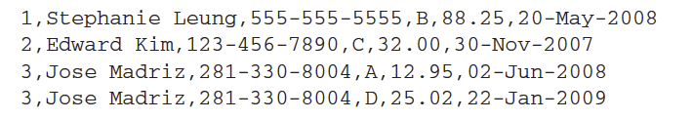
The Inner join
What is the inner join?
Consider the following two files:
Customer information file (customer ID, Name, Phone Number)
1, Stephanie Leung, 555-555-5555
2, Edward Kim, 123-456-7890
3, Jose Madriz, 281-330-8004
4, David Stork, 408-555-0000
Customer orders file (customer ID, order ID, price, purchase date)
3, A, 12.95, 02-Jun-2008
1, B, 88.25, 20-May-2008
2, C, 32.00, 30-Nov-2007
3, D, 25.03, 22-Jan-2009
When you perform the inner join on the two input files on the customer ID attribute you get the following:

Slide 36
Can you think of a way of processing this using MapReduce?

Slide 37
Two Approaches
Repartition join
Replicated join

Slide 38
Repartition join
The question is how do we use a single map and a single reduce to perform the join when the input is from two different input files.
  Get the mappers to process both input files. For this example assume each file fits in 2 blocks.
Mapper 1 Mapper 2 Mapper 3 Mapper 4
File 1 block 1
File 1 block 2
File 2 block 1
File 2 block 2

Slide 39
Repartition join
What should we use as the output key of the map task?
  The join attribute
    This is because we want all the records with the same join attribute to go to the same reducer
What else do we need?
  We need a way of knowing which file the record belongs to in order to join tuples from opposing files.
  Need to add a tag indicating which file it came from onto the output value of the mapper.
Once we have done the above it will be quite easy for the reducer to take all the records with the same join attribute and then combine them to create the desired output.

Slide 40
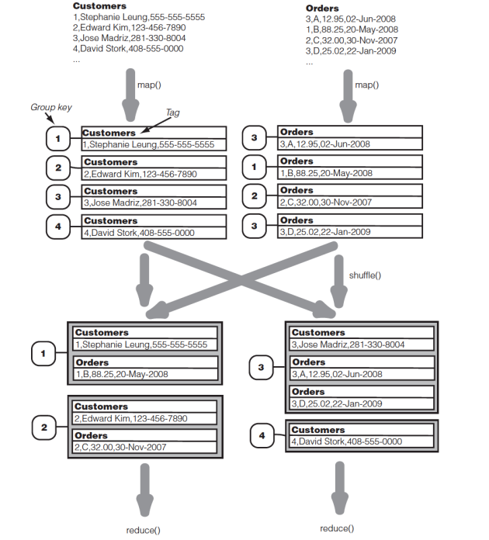
Repartition join
The output key of the mapper is the customer id which is labeled as the group key in the diagram
Note the tag needs to be placed with the output value of the mapper.
Note each reducer gets all of the customer and order records with the same customer ID.
The reducers can then perform the rest of the join locally.

Slide 41
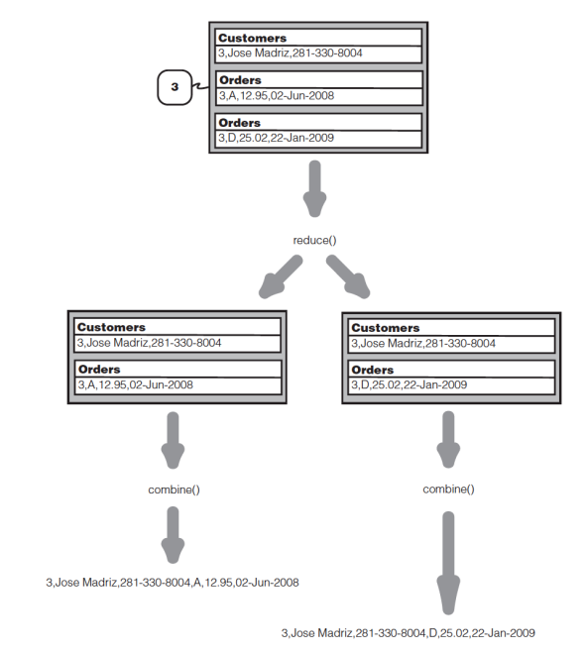
Reduce side of the repartition join

Slide 42
Reduce side of the repartition join
You can write the java code for the repartition join as an exercise for yourself.
There is already an implementation of it in the following java package
  Org.apache.hadoop.mapreduce.lib.join
Normally if I wanted to do a join in Hadoop I would use
  Pig or
  Hive
They are much easier to use.
We will teach the above to you soon.

Slide 43
Replicated Join
File 1 block 1
File 1 block 2
File 1 block 3
File 1 block 4
File 2
File 2
File 2
File 2
Mapper 1 Mapper 2 Mapper 3 Mapper 4
The small file 2 is replicated to each map node.
Each mapper joins the records of one block of file 1 with all the records of file 2
The mapper works by placing the records of file 2 inside a hash table using the join attribute as the hash key.
Then it iterates through all the records of file 1 probing the hash table of records of file 2.

Slide 44
How do we replicate file 2 to all the mappers?
We can use the distributed cache to do that.
The distributed cache can be used to copy a file to the local directories of all the task nodes.
Then each of the task nodes can use the file in their local directory for processing.

Slide 45
Oozie
Start
MapReduce
Fork
Pig
MapReduce Streaming
End
MapReduce
Pipes
Join
Java
Decision

Slide 46
Oozie
Oozie workflows are actions arranged in a control dependency DAG (Direct Acyclic Graph)
Action Nodes
  MapReduce
  MapReduce streaming
  MapReduce pipes
  Pig
  Hive
  File system
  Java
  Sqoop import
  Etc.
Control flow nodes
  Decision
  Fork (spawn multiple action nodes)
  Join (wait for all action nodes to finish before proceeding)
Cycles in workflows are not supported.

Slide 47
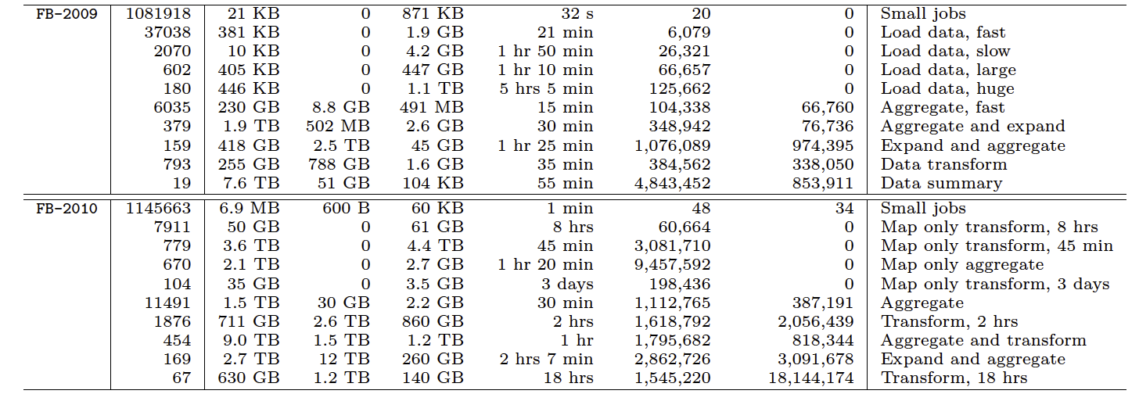
Facebook Workloads
Source: Yanpei Chen, Sara Alspaugh, Randy Katz, Interactive Analytical Processing in Big Data Systems: A Cross-Industry Study of MapReduce Workloads, VLDB 2012

Slide 48
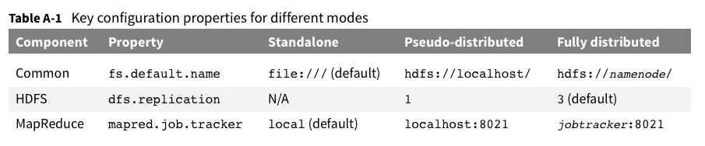
Three Hadoop Modes
Fully Distributed
Pseudo distributed
  Everything running on a single computer
Local Job Runner
  All in one JVM
  Good for testing

Slide 49
Hadoop Distributions
Three major Hadoop distributions
Cloudera
  Written completely in Java
  Only works with Linux
HortonWorks
  Supports both Linux and Windows
MapR
  Linux
  Amazon Web Services (AWS) Elastic MapReduce allows this to be selected.
  Daemons written in C++
  Programming mappers and reducers still in Java

Slide 50
Conclusion
In this lecture we learnt:
  How the MapReduce framework in Hadoop works underneath
  How HDFS works underneath
  Advanced MapReduce

